Slide 1
Python week 1
Canberra Chinese School Sem1

Slide 2
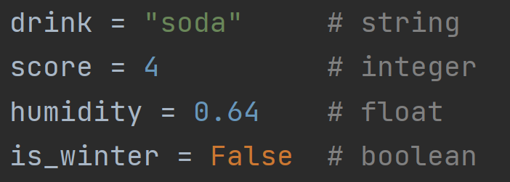
A Quick Review
For i in list:
do something
Here, list needs to be something that we have defined already.
But “i” can be named whatever you like.

Slide 3

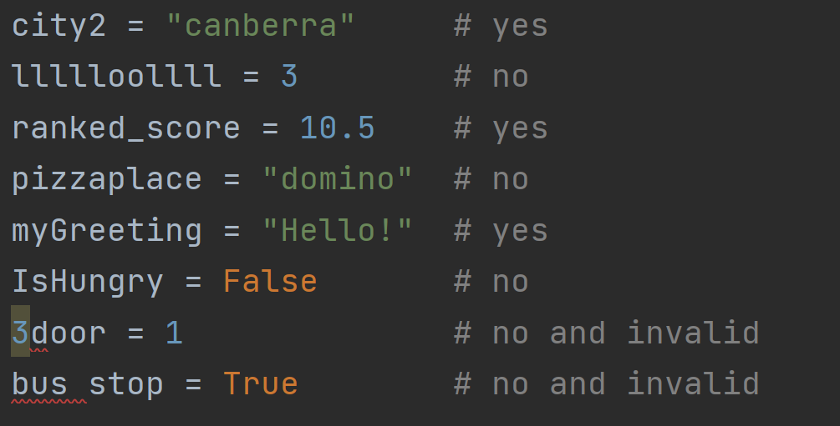
Are these good names for variables?

Slide 4
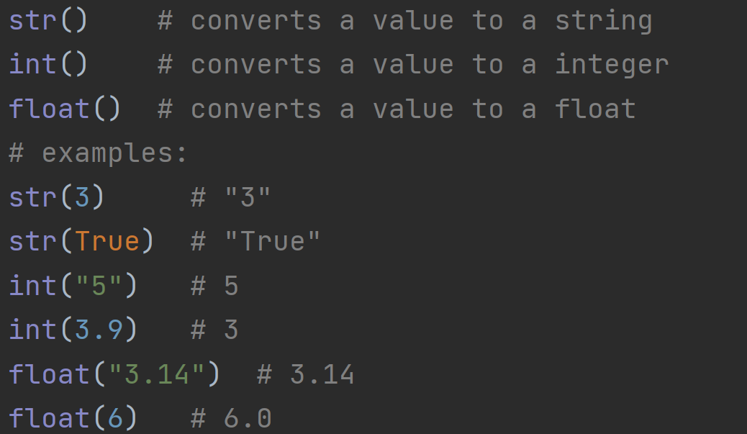
Type Conversion

Slide 5
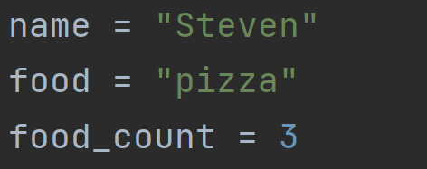
Multiple Declaration of Variables
Is the same as

Slide 6
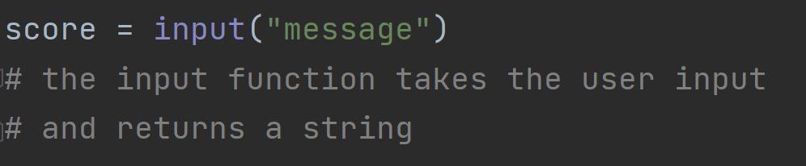
User input

Slide 7
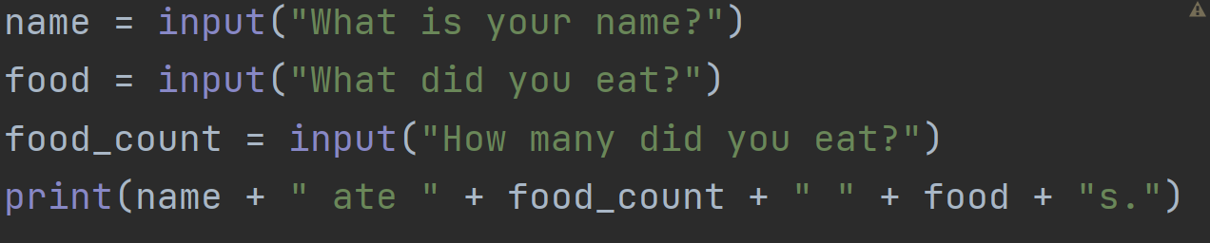
Quiz 1
How to shrink this script into only two lines? Answer:

Slide 8
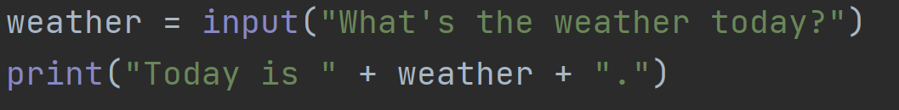
Quiz 2
Answer: C
What happens immediately after you run this script?
A. It prints “Today is…”
B. It prints “What’s the…” and stops
C. It asks you “What’s the
weather today?” and waits
for user input
D. It looks outside and finds out
today’s weather

Slide 9
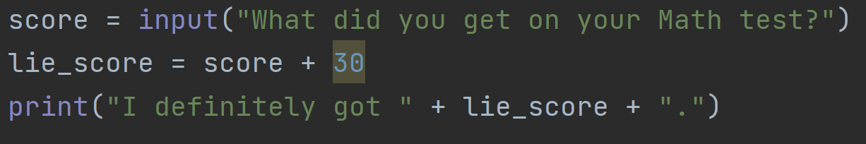
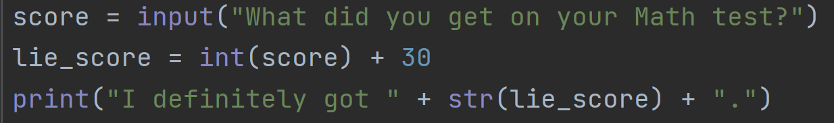
Quiz 3
What’s the problem with this program?
Answer: The score variable is a string!
A string cannot be added to an integer.
Fix:

Slide 10
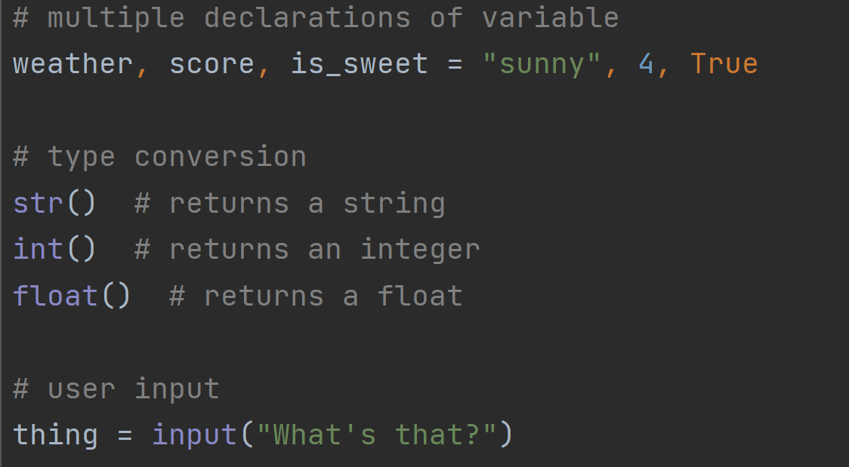
Summary

Slide 11

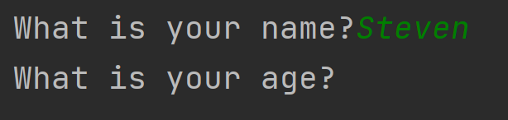
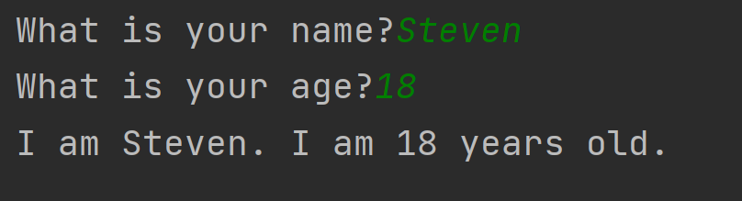
Exercise

Slide 12
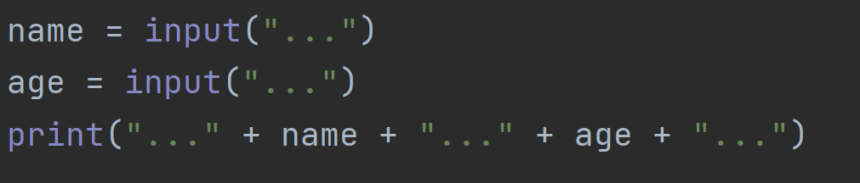
Exercise
Hint:

